Slide 1
NYC Taxi Green -2 Capstone Project
Ashish Thomas John
Data Engineer Trainee - Cyann

Slide 2
Project Overview
This project demonstrates an end-to-end Data Engineering pipeline using Microsoft Fabric.
The NYC Green Taxi dataset was ingested into Bronze, transformed into Silver, modeled into Gold in star schema tables, and visualized using Power BI.
Buisness Questions Solved.
How is the share of buisness as per working v/s weekend day?
Which locations are under high risk category?
Show which location have the most pickups and where those trips usually end?

Slide 3
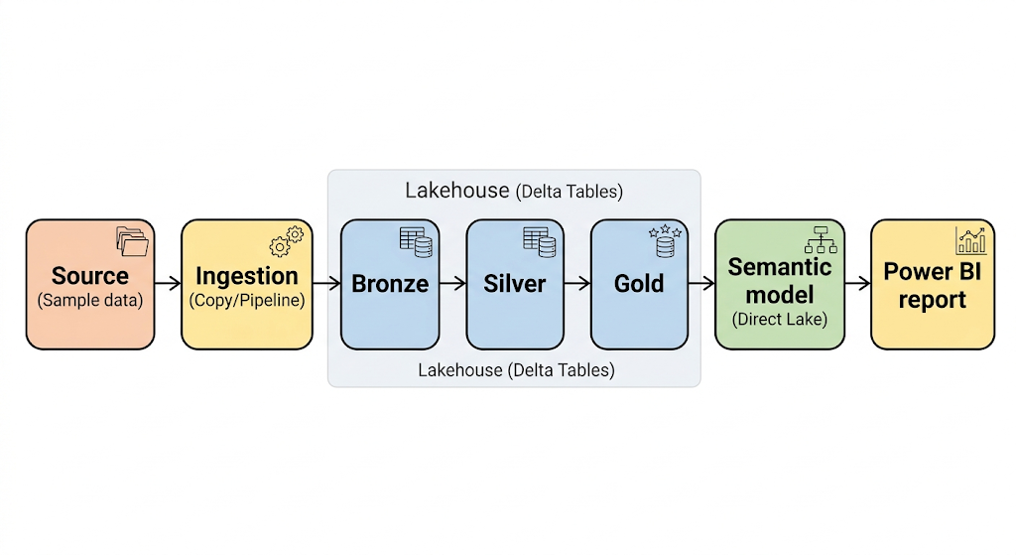
Tech Stack
1. Microsoft Fabric
2. Lakehouse
3. Python/SQL/Pyspark
4. Power BI
5. Direct Lake Semantic Model
Workflow of the project.

Slide 4
Let’s move to report and implementaion

